Slide 1
Polymorphism
Creative Commons Attribution-NonCommercial-ShareAlike 3.0 Unported License. http://creativecommons.org/licenses/by-nc-sa/3.0/
Written by Rachel J. Morris, last updated 2016-03-13

Slide 2
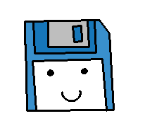
Before we get into virtual functions, let's review a couple things about classes and inheritance...

Slide 3


Pointers to Classes
We might want to have a pointer of the base class' type, and point to any children, to write generic code that can handle any specialization...
So how do we make sure that the function called is the one that belongs to

Slide 4
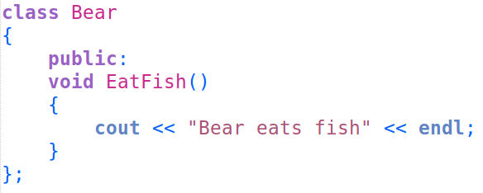
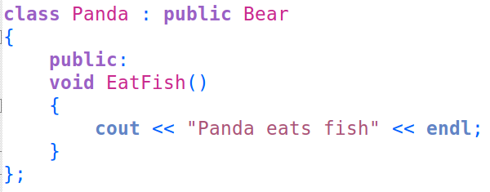
Function Overriding
#1
When you have one class inherit from another class, you can override (or overwrite) a parent class' functions with new functionality:
Original
Overwritten

Slide 5
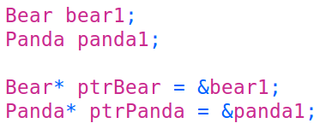

Pointers to Classes
#2
We can also utilize pointers to point to a specific class
When two classes are related, we can create a pointer for the parent data-type, and point it to a child's address.
However, if we do this, when we call the overwritten function, it will call the original parent version.

Slide 6
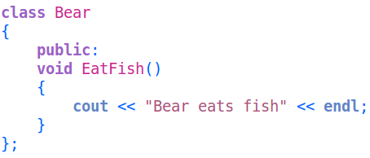
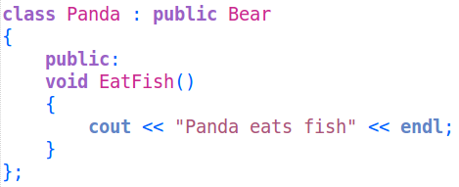
Pointers to Classes
We might want to have a pointer to the base class, and point to any children, to write generic code that can handle any specialization...
So how do we make sure that the function called is the one that belongs to the correct data-type, and not just the generic parent?

Slide 7
Virtual Functions

Slide 8
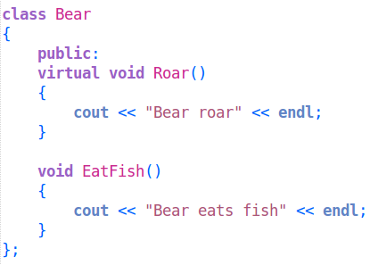
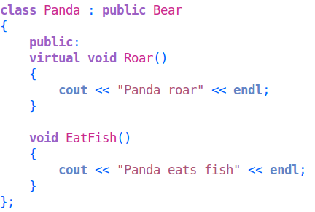

Virtual Functions
Here we have a parent class and a child class.
In the parent class, there is one virtual function, and one non-virtual function. Both of these are overwritten in the child class.
We will have a Bear* pointer to a Bear object and a Panda object.

Slide 9
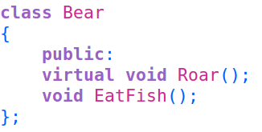
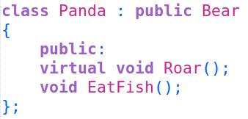

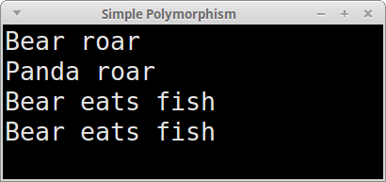


Virtual Functions
What happens if we call each function through the pointers?
Notice that with the non-virtual function, the Bear version gets called both times.

Slide 10
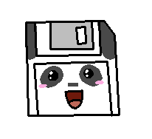
Virtual Functions
What happens if we call each function through the pointers?
But with the virtual function, even though the pointer is a Bear* type, the Panda version is called.

Slide 11

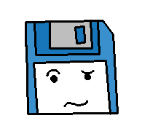
Virtual Functions
By utilizing virtual functions, we can now write programs that utilize pointers to handle many different classes that have a common parent.
The program doesn't care about what exactly the class is, but can operate on the specialized implementations (child classes) via the
common interface, which was defined by the parent class.

Slide 12
Abstract Classes &
Pure Virtual Functions

Slide 13
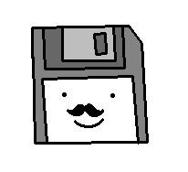
Abstract Classes
By utilizing virtual functions, we can now write programs that utilize pointers to handle many different classes that have a common parent.
Sometimes, we don't want the user to actually create an instantiation of the parent object – perhaps it is just defining the interface that all the children will use.
We can make a class into an abstract class, so that it cannot be instantiated as an object – but its children can.

Slide 14
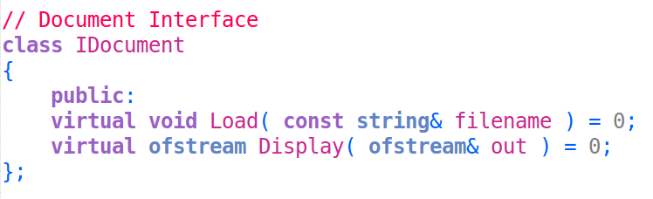
Abstract Classes
If we were writing a program to handle multiple types of Documents on a computer, we might know that they all share a common functionality.
We can declare a Load and Display function in the class as
pure virtual functions
by ending the declared line with a = 0;
By doing this, we can no longer create an instantiation of IDocument, but when we create a child of IDocument, it is required that we define these functions in each child.

Slide 15
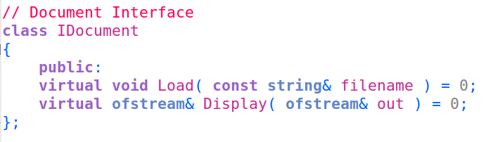
Abstract Classes
If we were writing a program to handle multiple types of Documents on a computer, we might know that they all share a common functionality.
We can declare a Load and Display function in the class as
pure virtual functions
by ending the declared line with a = 0;
By doing this, we can no longer create an instantiation of IDocument, but when we create a child of IDocument, it is required that we define these functions in each child.

Slide 16
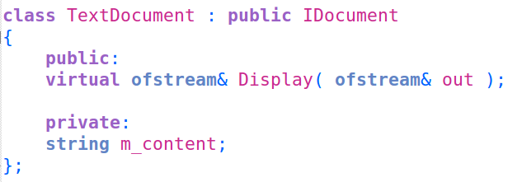
Abstract Classes
If we do not overwrite these pure virtual functions within a child class, then the child class is also abstract and cannot be instantiated.
(missing Load)

Slide 17
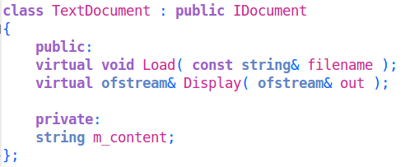
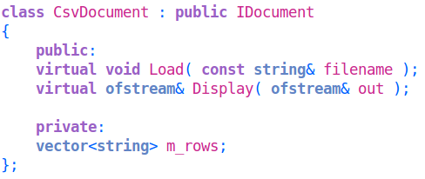
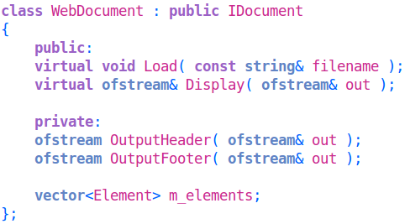
Abstract Classes
Each type of document might be implemented wildly differently, but we know that each one needs a Load function and a Display function, so we enforce it via the common parent class, the IDocument interface.

Slide 18
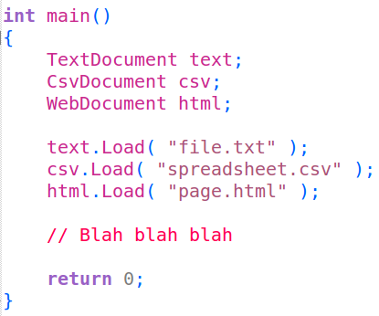
But what good is having an interface if we have to write duplicate code for each child?
Well, we don't have to...

Slide 19
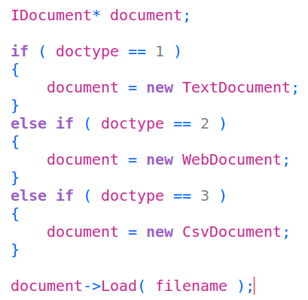
Using pointers, we can treat all documents like an IDocument, and our code doesn't need to care or differentiate between each child type.
We point to a child, but our pointer is of the type parent*...

Slide 20
Polymorphism

Slide 21
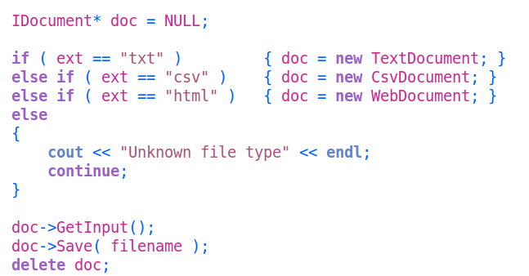
Polymorphism
Now we get into Polymorphism
Utilizing an abstract base class is not required to use polymorphism; we can use a pointer of any base-class-pointer type
Each IDocument child has GetInput() and Save(...)
The main idea is that we can write generic code.
No need to duplicate the same code for each type of child;
we simply treat them all the same through their common parent interface.

Slide 22
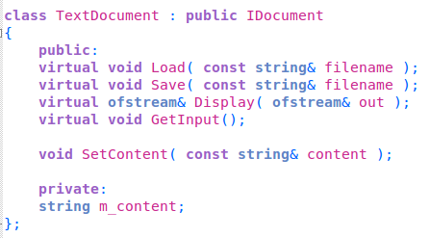
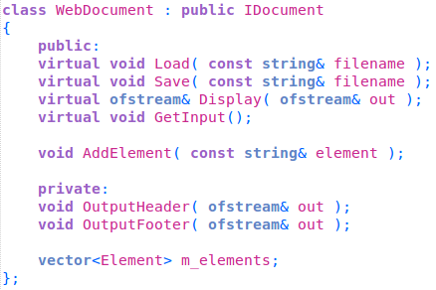
Polymorphism
There is a common interface, but each child class (specialization) can have additional functions to get its job done.

Slide 23
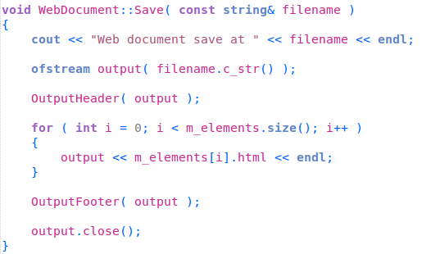
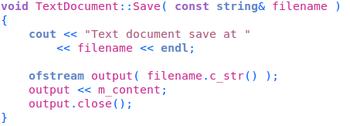
Polymorphism
There is a common interface, but each child class (specialization) can have additional functions to get its job done.
Each specialization has its own inner-workings, but to the program in general,
all it cares about is that a “Save” function can be called.

Slide 24
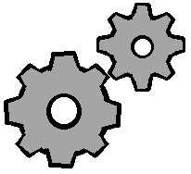
Late Binding
Late Binding, or Dynamic Binding,
occurs when we utilize the virtual keyword.
This causes the program to figure out which function to call at run-time.

Slide 25
The Virtual Table
Late Binding utilizes something called the
Virtual Table, which is often also called the vtable.
This is essentially a table of functions declared as virtual.
The vtable contains pointers to functions,
which we have not learned how to implement ourselves yet.
Every class that has virtual functions
(either declared in its parent or in itself)
has a vtable.

Slide 26
The Virtual Table
This is why the correct function gets called
even if the pointer is of a parent* type.
If the function is not virtual,
the function called is the one that is the same data-type as the pointer.
Virtual
Not virtual

Slide 27
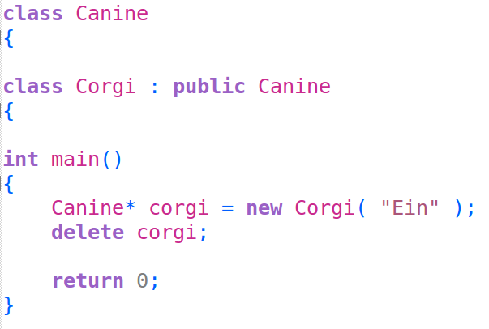
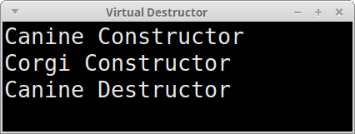
Virtual Destructors
When using virtual functions and inheritance,
you will want to make sure that any
Destructor that you create is virtual.
We want to make sure that the correct destructor is called when an item is destroyed.
Notice that only the Canine destructor is called!

Slide 28
Virtual Destructors
If we created a dynamic variable with the new keyword, using a Parent*, without the virtual keyword added to the destructor it would try to call the parent's destructor!
This could cause memory problems if the child class allocates any memory as part of its implementation,
If the parent class destructor is called, then any memory managed by the child will not be handled appropriately!

Slide 29
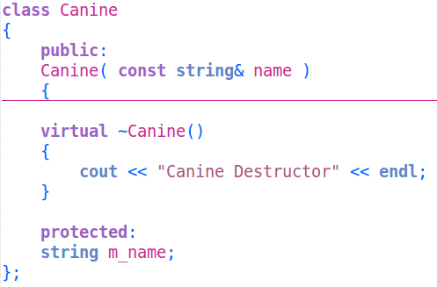
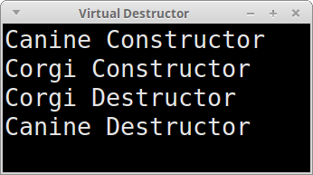
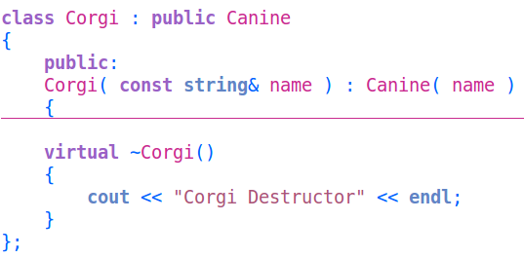
Virtual Destructors
With all destructors being virtual, each destructor in the family will be called.
Without this, there could be memory handled in one class somewhere in the family, but never freed.

Slide 30
So now that we've covered all this information about virtual functions, abstract classes, and polymorphism,
let's put it into practice
with a sample program!

